Slide 1
REAL ESTATE ADVISORY SERVICEs
April 30, 2020

Slide 2
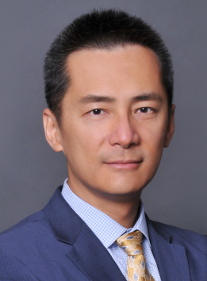
JOHNSON CHIEN, CCIM
2
Professional Background
Johnson Chien, CCIM, is a Director in the City of Industry office of Newmark Knight Frank (NKF). At NKF, Johnson’s mission is to provide unsurpassed services and expertise to buyers, sellers, tenants, landlords, investors and developers of real estate on a local, regional and national level, as well as to clients and investors from the Greater China Region.
Prior to joining NKF, Johnson was a Senior Valuation Specialist at Colliers International Valuation & Advisory Services. Before Colliers International Valuation & Advisory Services, Johnson was one of the elite commercial real estate Senior Consultants at Deloitte Financial Advisory Services, LLP. Before Deloitte Financial Advisory Services, LLP, Johnson served as a Senior Associate at Duff & Phelps, LLC’s commercial real estate group where he sourced multi-million dollars of consulting fee leads during the financial crisis of 2007-2008.
Johnson began his real estate career in 1993 while studying business administration and real estate finance at University of Southern California (USC). Since graduation, Johnson began to perfect his real estate acumen through various commercial real estate disciplines such as brokerage, financial modeling, landlord advisory, property management, and consultation and valuation.
Johnson’s past experience includes commercial real estate consultations and valuations for all major property types such as office towers, industrial buildings, regional malls, neighborhood and community shopping centers, apartments, student housing, ultra-luxury condominium developments, golf courses, resorts, marinas, mixed-use developments, senior housing, hospitals, healthcare-related facilities, subdivisions sell-out, vacant lands, bank branches, and fast-food restaurants. Other notable expertise includes analyses of pre- and post- acquisition of real estate portfolios owned by REITs, public companies, and institutional investors for financial reporting purposes. These analyses include ASC820 – Fair Value Measurements and Disclosures, ASC 805 – Business Combinations, and ASC 350 – Goodwill and Other Intangible Assets.
Additionally, Johnson is an experienced international real estate consultant for multinational corporations (MNCs) with high-tech facilities, industrial properties and office buildings located throughout Asia and North America.
Cumulatively, Johnson has completed more than $20 billion dollars of real estate transactions for leasing, sales, analyses pursuant to financial reporting standards, appraisals, and highest & best use studies.
Johnson Chien, CCIM
DIRECTOR
Newmark Knight Frank
13191 Crossroads Parkway North, Suite 555
City of Industry, CA 91746
CA DRE License 01121758
T 562.364.2022
C 626 255 5280
F 562.695.0980
E JChien@ngkf.com
Years of Commercial Real Estate Experience
Since 1995
Areas of Specialization
Industrial Sales & Leasing
Retail Sales & Leasing
Investment Sales
Consultations & H&BU Studies
Build-To-Suit Negotiations
New Development Projects
Professional Affiliations
Certified Commercial Investment Member (CCIM)
California Department of R.E. Broker License
California Bureau of R.E. Appraisers - Certified General
Appraisal Institute - Candidate for Designation
National Association of Realtors

Slide 3
3

Slide 4
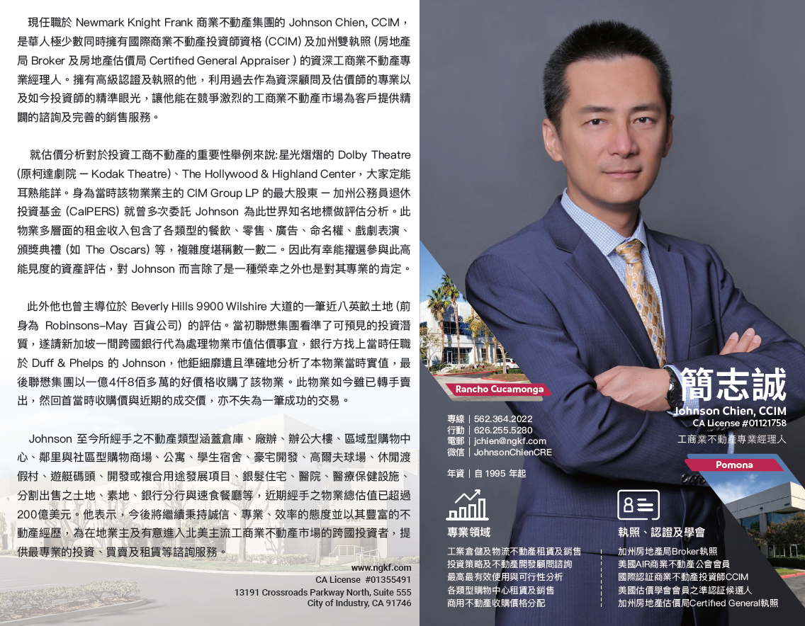
4

Slide 5
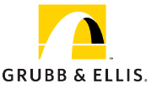
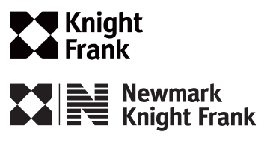
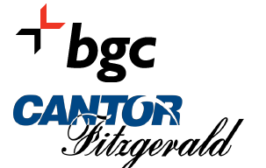
OVERVIEW
NEWMARK KNIGHT FRANK
5
Newmark Knight Frank is one of the world's leading commercial real estate advisory firms. Together with London-based partner Knight Frank and independently-owned offices, NKF’s 18,000 professionals operate from more than 480 offices in established and emerging property markets on six continents.
With roots dating back to 1929, NKF's strong foundation makes it one of the most trusted names in commercial real estate. NKF's full-service platform comprises BGC's real estate services segment, offering commercial real estate tenants, landlords, investors and developers a wide range of services including leasing; capital markets services, including investment sales, debt placement, appraisal, and valuation services; commercial mortgage brokerage services; as well as corporate advisory services, consulting, project and development management, and property and corporate facilities management services. For further information, visit www.ngkf.com
1929
2012
2016
2017
2018
2019
is founded in Manhattan
The CRE Group
Project Management
Capital Markets
Key Market Expansion
Boston/Washington, D.C./
Southern California
Continental Realty
Ohio
Rudesill-Pera Multifamily
Tennessee
Latin America Office
Mexico City
Walchle Lear
Multifamily
Jacksonville Beach, FL
Valuation and Advisory
Reformation
MLG Commercial
Midwest Expansion Across Wisconsin
Frederick Ross
Denver
Smith Mack
Philadelphia
Regency Capital Partners
Acquired assets of premier
San Francisco Real Estate Advisory Business
Jackson Cooksey
Leading Corporate Tenant Advisory
2006
Newmark Group, Inc. Acquires ACRES
Salt Lake City
International
Alliance
2014
Retail Services
Spring 11 LLC
Debt & Equity Specialties
MiT National Land Services
Newmark Group, Inc. acquires innovative CRE workflow solutions provider, Workframe, Inc.
National Multifamily
(16 companies)
Berkeley Point Financial, LLC
Multifamily Lender and Loan Servicer
Former IRR Valuations Businesses
(4 Companies)
2011
Northern California
BGC PARTNERS,
Controlled by Cantor Fitzgerald, acquires Newmark
2015
Partnership with E Smith
Legacy Holdings LLC
Former IRR Valuations Businesses
(5 Companies)
Newmark IPO
NASDAQ: NMRK

Slide 6
Nkf’s comprehensive platform
6
NKF has experienced tremendous growth and the momentum continues to build. NKF’s fully integrated platform of services provides clients with a single-source solution for every phase of owning or occupying a property. We service prominent multinational corporations and institutional investors across the globe as well as owners, occupiers and developers of real estate. Additionally, as a leader in real estate technology, we utilize the most high-tech tools in the industry along with our deep bench of knowledge, data and research to optimize businesses and properties.
Leasing
advisory
consulting
Capital
markets
Program
& Project management
multifamily
capital markets
Property & facilities
management
valuation
& Advisory
retail
services
global
Corporate services
Industrial & Logistics
services

Slide 7
NKF CORPORATE ACTIVITY
u.s. transaction snapshot
$3.3B+
Annual revenue
Leasing Transactions
15,520
Sales/financing Transactions
3,813
Consulting Transactions
13,877
Total u.s. Property & Facilities management
195,518,730 sf
$96.7B
Capital Markets volume**
Total global Property & Facilities management
403,140,468 SF
33,210
Total transactions
18,000+
employees
Total u.s. exclusively leased space/properties
511,948,984 SF
480+
offices
3,475
people
151
offices
20
countries
58
Countries
5,613
people
144
offices
5,613
people
144
offices
europe
europe
u.s.
europe
u.s.
8,266
people
154
offices
15
countries
214
people
16
offices
10
countries
8,266
people
154
offices
15
countries
214
people
16
offices
10
countries
80
people
3
offices
2
countries
Asia pacific
631
people
21
offices
10
countries
Asia pacific
CanadA & latin America
Asia pacific
CanadA & latin America
Middle east
africa
africa
* FY 2018 Business activity statistics
*Figures include London-based partner Knight Frank and independently-owned offices
**Includes all commercial and multifamily investment sales, mortgage brokerage and debt origination volumes

Slide 8
工業不動產現況
與
新冠疫情影響下
商業不動產租賃合約的新挑戰

Slide 9
CURRENT
INDUSTRIAL REAL ESTATE MARKET CONDITIONS
AND
EXPLORING COMMERCIAL REAL ESTATE
LEASE PROVISIONS
IN THE WAKE OF COVID-19

Slide 10
何謂商用不動產?
非住宅以外之不動產都統稱為商用不動產，就廣義來看，所有作為商業使用收益之不動產都可統稱為商用不動產。但如果詳細分類，可因各種不動產之使用屬性分成商業不動產、休閒不動產、工業不動產以及特殊目的不動產等。如商業不動產包括辦公大樓、百貨公司、商場、購物中心等；遊樂園、渡假村、休閒住宅、俱樂部等為休閒不動產；工業廠房以及廠辦等則屬於工業不動產，而醫院、煉油廠等其他項目則可歸類為特殊目的使用之不動產。

Slide 11
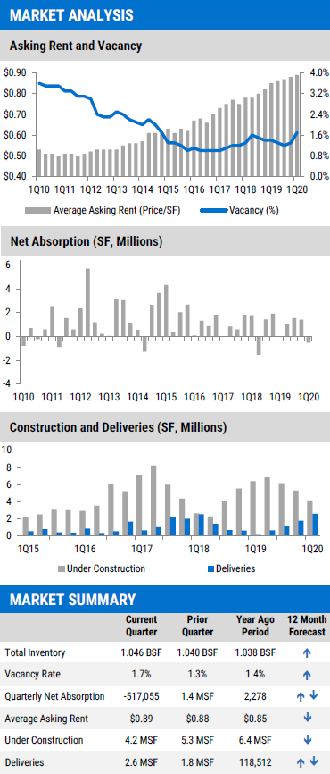
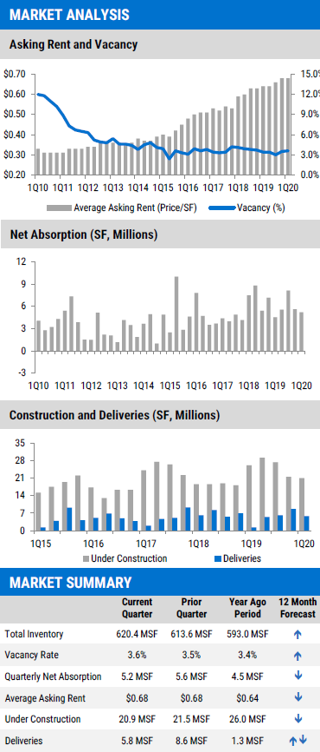
1q-2020 INDUSTRIAL MARKETS
LOS ANGELES COUNTY
INLAND EMPIRE

Slide 12
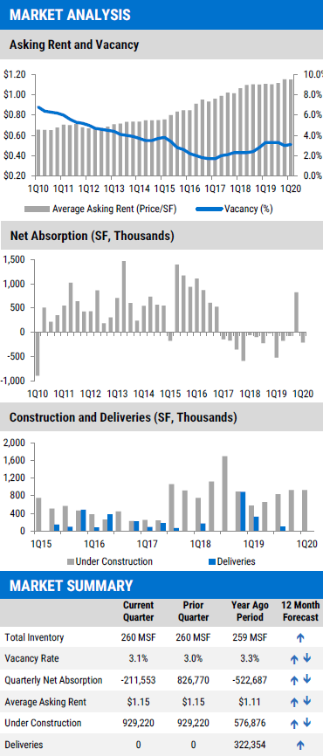
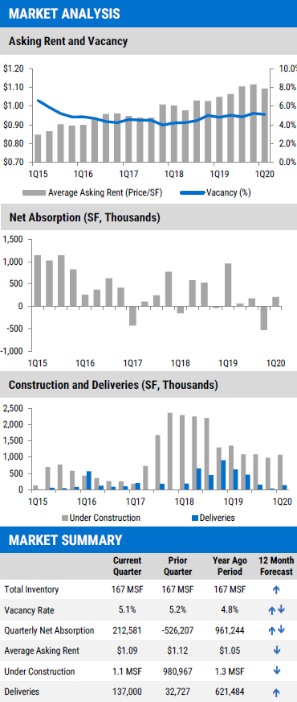
1q-2020 INDUSTRIAL MARKETS
ORANGE COUNTY
SAN DIEGO COUNTY

Slide 13
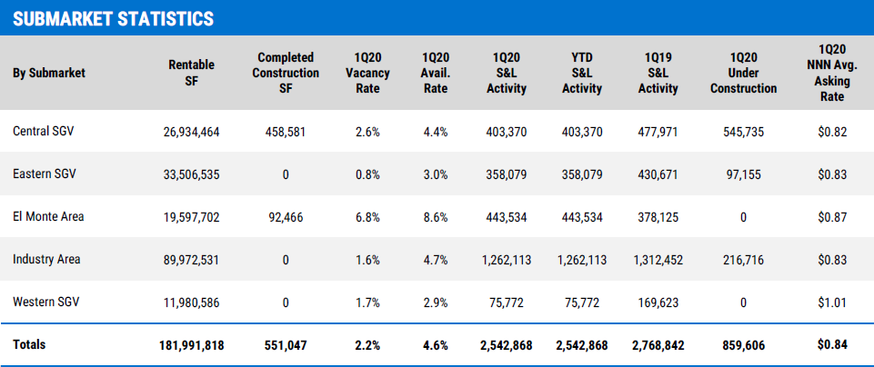
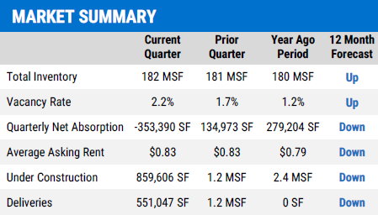
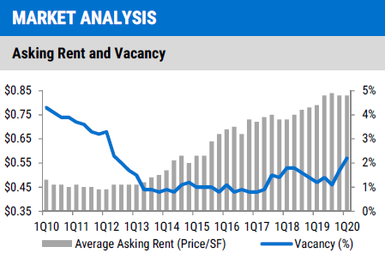
1q-2020 INDUSTRIAL MARKETS
San Gabriel Valley

Slide 14
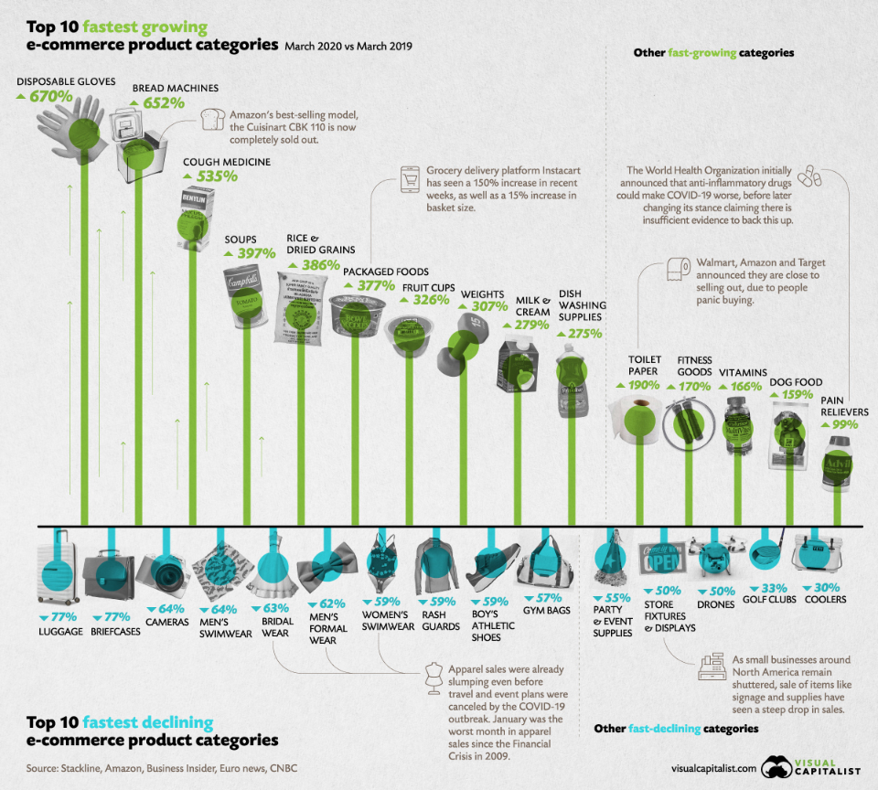
WHAT SHOPPERS ARE Buying online during covid-19?

Slide 15
COMMUNICATION, COMMUNICATION, COMMUNICATION
“Location, location, location." You may have heard or said this maxim when talking to your business associates, families, or friends about the property values or lease rates. In the wake of COVID-19 pandemic, “communication, communication, communication" might be the best advice for both Lessees and Lessors.

Slide 16
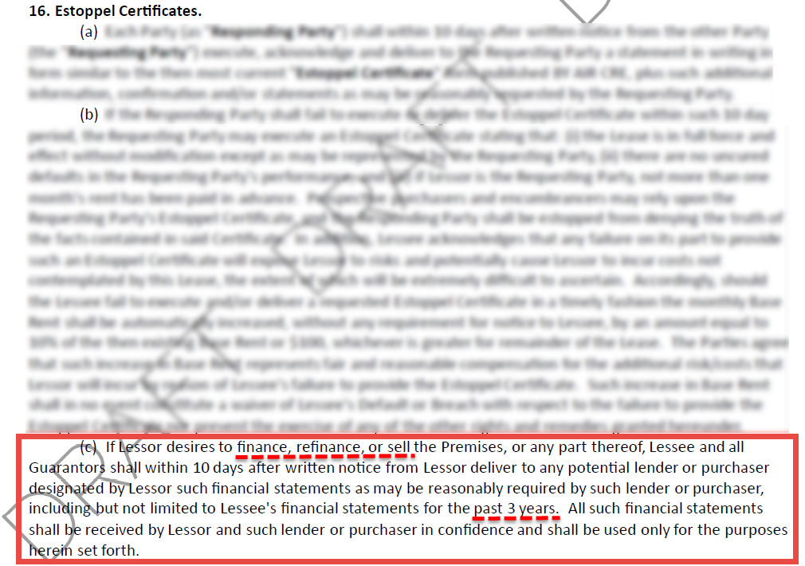
Lessor’S Demand OF Financial Statements From Lessee during covid-19?
The COVID-19 pandemic has caused widespread business closures, many Lessees are requesting rent relief from their Lessors, in the form of deferral or abatement. Lessors are more curious than ever to understand the financial situation of Lessees. Under the AIR CRE Leases, is Lessee required to provide financial statements upon Lessor’s demand?
Answer: Yes, but only if the purposes of reviewing Lessee’s financial statements are related to finance, refinance, or sell the Premises.
However, if a Lessee’s business operations have been negatively impacted by the COVID-19 pandemic, then, in a good faith attempt, Lessee may consider providing recent sales figures, bank statements, and audited financials and tax returns to Lessor to support Lessee’s rent relief request.

Slide 17
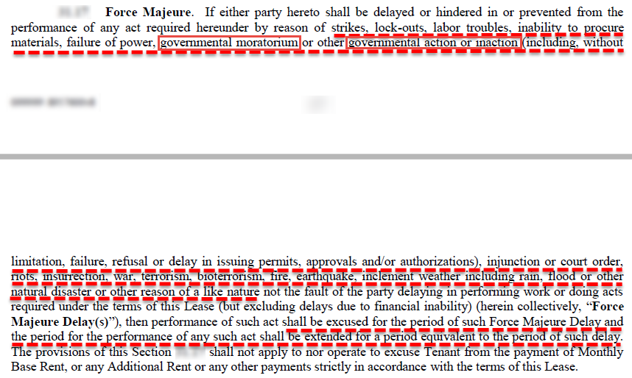
Does the “Force Majeure” Event of COVID-19 Excuse Rent Payment Under AIR CRE Leases?
Answer: No. There is no Force Majeure provision in the AIR CRE Leases.
However, in custom leases (please see the sample custom lease below) which include a Force Majeure provision, the obligations of the Lease can typically be delayed as a result of a Force Majeure event.

Slide 18
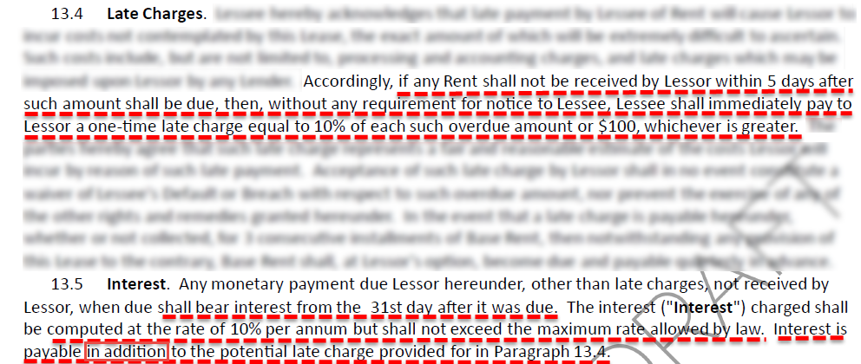
Lessor’S RIGHT TO COLLECT LATE CHARGES AND INTERESTS From Lessee during covid-19?
Answer: Yes. Lessor is entitled to collect a late charge of 10.0%, or $100, whichever is greater, if Lessor does not receive Rent within the five-day grace period. Additionally, Lessor is also entitled to interest at 10.0% that begins to accrue on the 31st day from Rent was due.
However, some Lessors often do not strictly enforce the late charges and interest provisions.

Slide 19
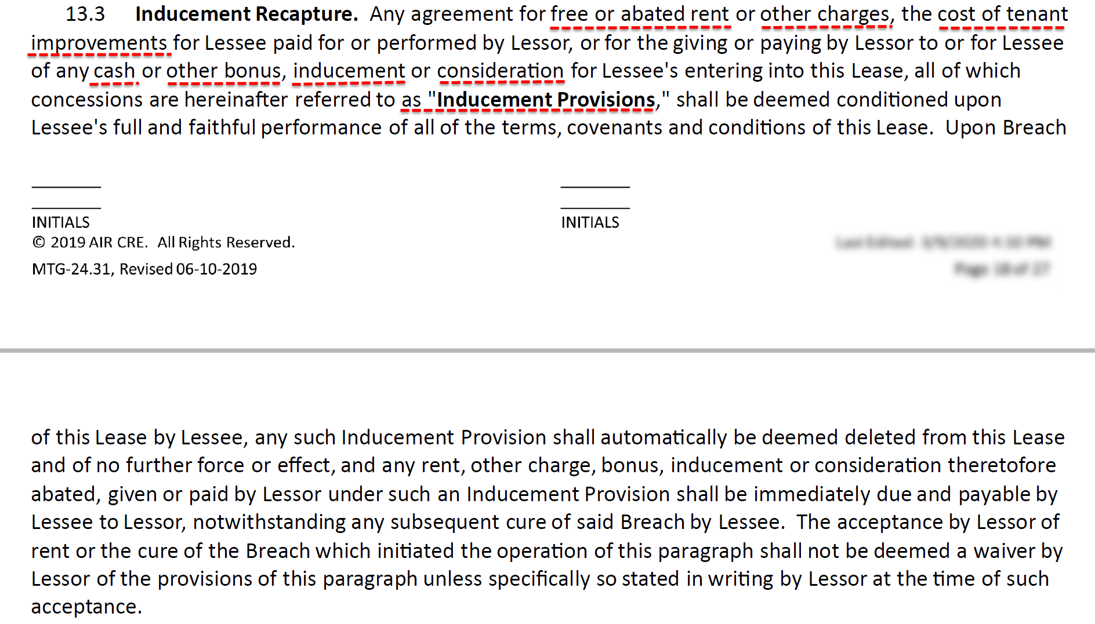
What are Lessee’s obligations under air cre inducement recapture provision?
Answer: Lessee is required to immediately pay Lessor the value of any free rent, TI allowance, repairs specific to the leased Premises, etc. when a Breach is committed by Lessee.
However, in most instances, Lessee may be asked to pay the FULL value of the free or abated rent, TI allowance, etc. if Lessee commits the Breach near the end of the Lease term. Lessee may negotiate with Lessor for prorations and be responsible for the unamortized free rent, TI allowance, repairs specific to the leased Premises, etc.

Slide 20
COMMUNICATION, COMMUNICATION, COMMUNICATION
Advice for Lessees
Don’t engage counsel and create adverse situation
Do pick up the phone and call the Lessor – have discussion and develop mutually acceptable solution
Do not stop paying rent altogether without first initiating a respectful and proactive dialog with Lessor
Advice for Lessors
Proactively engage with Lessees – start with large Lessees first
Be open to flexible arrangements (The Irvine Company in SoCal proactively approaching all Lessees and offering rent abatement and the amortization of it over the following year)
Be aware of legislation being proposed that will mandate rent forgiveness – corresponding insurance implications and Federal stimulus backstops
DOCUMENTATION
Proof of current or pending application for governmental assistance
Details on any governmental assistance received
Proof of a denial of a business interruption insurance claim
Proof lender concessions
CONSIDER… Adding Pandemic/National Emergency clause in all leases that specifically allows for rent abatement during period that federal, state or local government requires a shutdown of business and Lessee is unable to access Premises.

Slide 21
何謂資本化率（資本還原率）?
CAPITALIZATION RATE 資本化率（資本還原率），通常我們將其簡寫為 ”CAP RATE”，意指淨收益 (NOI) 與不動產資產價值的比率，因此，舉例來說，若一房地產其出售的價格為 $10,000,000，而其淨收益為 $1,000,000，則此物件之資本化率為 $1,000,000/$10,000,000，即 10.0% 。
資本化率 = 淨收益 / 不動產資產價值
資本化率所代表的意義為何？
意即投資者以現金購買不動產資產的投資報酬率。

Slide 22
What is a cap rate?
The CAPITALIZATON RATE, often just called the “CAP RATE,” is the ratio of Net Operating Income (NOI) to property asset value. So, for example, if a property recently sold for $10,000,000 and had an NOI of $1,000,000, then the cap rate would be $1,000,000/$10,000,000, or 10.0%.
CAP RATE = NOI / VALUE
What is the cap rate actually telling you?
It represents the percentage return an investor would receive on an all cash purchase.

Slide 24
Johnson Chien
Director
13191 Crossroads Parkway North
Suite 555
City of Industry, CA 91746
562.364.2022
jchien@ngkf.com

